Slide 1
Sales Data Optimization
Detailed
Solution Description

Slide 2
Contents
  Introduction
  Sales Data Optimization Overview
  Heartbeat – Stock Out Reduction Tool
  SDO Implementation Methodology

Slide 3
Real Time Retail is a Mixture of “Art” and “Science”
The Retail Challenge
To Win, Retailers Must
Get Real
Right Product
Right Place
Right Time
Right Price
Right Way
Real Focused
Real Efficient
Real Smart
Real Close
All in Real Time
Sustainable growth will come from an increased understanding of consumers and the ability to meet their needs in real time

Slide 4

Real Time Retail – Driving Growth at the Point of Decision
Real-time connections with:
  Consumers
  Partners
  Stores
Significant impact on:
  Customer Service
  Inventory Management
  Pricing / Promotions
  Purchasing
Technology-enablers include:
  Collaborative Value Chains
    CPFR (Collaborative Planning Forecasting
    & Replenishment)
    CPC (Collaborative Product Commerce)
    SDO (Sales Data Optimization)
  In-store wireless CRM
  RFID / Auto-ID

Slide 5
Contents
  Introduction
  Sales Data Optimization Overview
  Heartbeat – Stock Out Reduction Tool
  Diagnostic Module: Benefits Calculation
  SDO Implementation Methodology

Slide 6
The SDO Architecture acts as a hub providing on demand access to store transactional data…
The Sales Data Optimization Architecture
Rapid Implementation Approach
Application Layer
Enterprise Process Improvement
Scalable architecture
Transaction templates
Standard message formats
Real time data access
Flexible operating environment
  In-store
  Corporate
  ASP model
Heartbeat – Stock Out Reduction Tool
Common Connectivity Layer
Infrastructure Layer
Building Blocks
Business
Applications
Infrastructure & Standards
Collaborative Processes
Organizational Change
… allowing a variety of services to analyze and respond to the store environment in real time.

Slide 7
The Building Blocks That are Necessary to Achieve Success
Business applications interact with sales data through the open standards of the common connectivity layer
The SDO architecture lays the foundation for data availability which can be leveraged for supply chain optimization and CRM opportunities
Business
Applications
Provides communications protocols and interface templates to allow solution partners to read data and execute processes consistently
Reduces implementation time
Increases accessibility of transactional data
Infrastructure & Standards
Enables stores, corporate, manufacturer and direct to store suppliers to work effectively together across company boundaries
Allows partners to understand information, make decisions and respond quickly
Collaborative Processes
Organizational
Change
Identifies opportunities to improve intra- and inter-enterprise operations
Enhances collaborative relationships between internal and external participants

Slide 8
Contents
  Introduction
  Sales Data Optimization Overview
  Heartbeat – Stock Out Reduction Tool
  SDO Implementation Methodology

Slide 9


Heartbeat – Stock Out Reduction Tool (SORT)
SORT
Findings From Pilot Implementations
Reduce out-of-stocks by 25%
Avg revenue increase of 1 - 2%
Avg revenue increase of top 200 items of 5 – 6%
Increase sales per square foot
Improve margins
Improve sales forecasting
Decrease inventory levels
Software
DATA VENTURES, SYSTECH
Op System
MICROSOFT W2K / UNIX
Hardware
INTEL / IBM
Wireless
PAGERS, PDA, CELLULAR
Web Svcs
MICROSOFT .NET

Slide 10
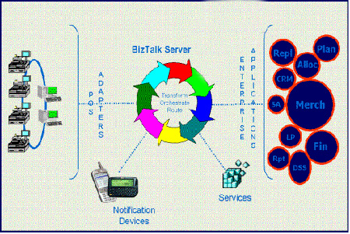
Heartbeat Out of Stock Scenario
1
3
2
4
Sales Transactions are fed through the standard POS Adapters into the BizTalk Server at fixed intervals (e.g., 15 min, 30 min, 1 hr)
The SORT algorithm processes transactional data to predict Out of Stock (OOS) conditions
An action oriented alert is sent to a store-based notification device (e.g., BlackBerry, PDA)
Store personnel correct the OOS condition by retrieving back room stock or placing an order

Slide 11
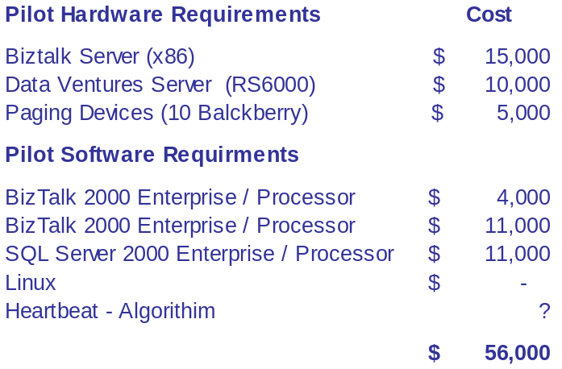
Pilot Architecture
Store Systems
W2K Biztalk Server
TLOG Data
VB 6
TLOG & Item
Preprocessor
Item Master
Data
BizTalk
Server
SQL
Server 2000
Data Ventures Unix Box
(RS6000)
VB 6
Notification
Preprocessor
OOS
Algorithm
Wireless Devices
Notification System
Blackberry
Device

Slide 12
Heartbeat - SORT Creates Value for Each Member of the Supply Chain
Manufacturer
Retailer
Consumer
Increase sales
Improve profitability
Improve brand loyalty
Reduce inventory
Improve staff utilization
Improve staff utilization
Improve margin
Increase sales
Increase stock turns
Reduce inventory
Decrease out of stocks
Improve product availability
Improve shopping experience

Slide 13
Contents
  Introduction
  Sales Data Optimization Overview
  Heartbeat – Stock Out Reduction Tool
  SDO Implementation Methodology

Slide 14
The PWC Consulting methodology delivers a structured approach to Sales Data Optimization implementations
SDO Implementation Methodology
Validate Opportunity
Analysis
Definition
Design
Deploy, Support, Improve
Construction
Deploy,
Support,
Improve
Project Management

Slide 15

Validate Opportunity
Activities
  Scope definition & rollout strategy
  Administer technical questionnaire
  Administer functional questionnaire
  Identify high value items / categories
  Preliminary architecture sizing for pilot & beyond
  Establish baseline metrics & high level ROI
  Develop preliminary project plan
  Validate project support
Duration
  3 – 5 days
Resources
  2 Functional Consultants
  1 Technical Architect

Slide 16
Analysis
SDO METHODOLOGY
Project Planning
  Validate Project Plan
  Identify project resources
  Validate timeline
  Validate project budget
  Define project controls and reporting methods
Envisioning
  Scope definition
  Identify items / categories to be tracked by “Heartbeat”
  Establish baseline metrics
Process Analysis
  Review ordering and inventory management processes
  Review current in-store stocking processes
Systems / Data Analysis
  Review existing technical environment
  Identify data sources and formats

Slide 17
Definition
SDO METHODOLOGY
Process Definition
  Define target re-stocking process for Heartbeat items
    Resource coverage
    Item / category prioritization
  Define target inventory management processes
    Store ordering
    Store replenishment
    Centralized purchasing
Define Reporting / Alert Requirements
  Define performance targets
  Define reporting requirements
  Define alert requirements / formats
Technical Definition
  Data requirements definition
  System definition (local server, centralized server, ASP)
  Infrastructure definition
  Hardware (servers, PDA, wireless)

Slide 18
Design
SDO METHODOLOGY
Design SDO Architecture
  Design Infrastructure
  Size Heartbeat applications and database
Design SDO Interfaces
  Map POS data elements
Design Reports / Alerts
  Design alert criteria / formats
  Design reports
Change Management
  Establish performance tracking processes
  Develop training program / set training schedule
    In-store processes
    Inventory management / ordering processes
Deployment Plan

Slide 19
Construction
SDO METHODOLOGY
Development
  Construct SDO interfaces
  Construct alert messages
  Construct reports
Testing
  Functional / integration testing
  Performance / stress testing
  User acceptance testing
Change Management
  Prepare training documents
  Train store personnel
  Knowledge transfer plans and processes
  Knowledge transfer performance measurements
Installation / Set-up
  Set-up infrastructure
  Install hardware / OS / database
  Install BizTalk / Data Ventures applications

Slide 20
Deploy, Support and Improve
SDO METHODOLOGY
Pilot Set-up and Testing
  Set-up initial pilot stores
  Test pilot stores
  Monitor pilot program / resolve issues
Deployment Planning
  Refine deployment plan based on pilot findings
  Execute roll out
  Provide on going support
Continuous Improvement
  Analyze results
  Identify improvement opportunities
  Expand program leveraging opportunities

Slide 21
Illustrative Project Timeline
SDO METHODOLOGY
Project Stages 1 2 3 4 5 6 7 8 9 10 11 12
Analysis
Definition
Design
Construction
Deploy, Support and
Improve
WEEKS

Slide 22
Illustrative Project Team
SDO METHODOLOGY
Executive
Sponsor
Program Management
Client
PwC Consulting
Applications
Change Management
Infrastructure
Application Architect
Business Analyst
Data Mapping Analyst
Programmers
Sources
Client
Microsoft
PwC Consulting
Systech
Business Process Analysts
Business Area Subject Matter Specialists
  Store Operations
  Buying
  Forecasting
  Replenishment
Training
Sources
Client
PwC Consulting
Network Architect
Hardware Architect
Database Architect
Middleware Architect
Infrastructure Analyst
Database Analyst
Middleware Analyst
Sources
Client
Intel
Microsoft
PwC Consulting

